Slide 1

Model Output Statistical Analysis

Slide 2
Terminating Simulation
Important observation: A significant number of students come in group of 2 and 4 fail to find a place to study, thus left the library
Question1: With 95% confidence level, what is the estimate of the average number of students failed to find seats so that it’s not deviate from the true mean by a small value
Question2: How many new seats should be added to decease the number of students failed to find seats to a reasonably small value

Slide 3
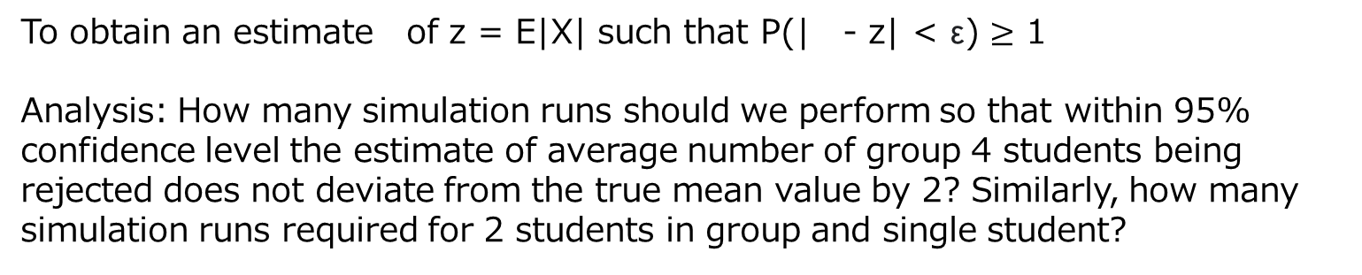
Approach
To obtain an estimate of z = E|X| such that P(| - z| < ε) $≥$ 1
Analysis: How many simulation runs should we perform so that within 95% confidence level the estimate of average number of group 4 students being rejected does not deviate from the true mean value by 2? Similarly, how many simulation runs required for 2 students in group and single student?
Procedure:
We make 100 simulation runs to get 100 realizations of z value
Gradually increase the number of runs until our 95 % confidence interval is smaller than 8
Return the mean value of the statistic based on current number of runs

Slide 4
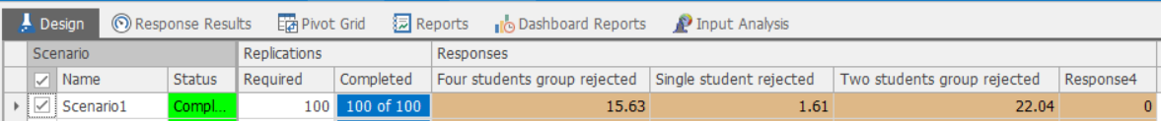
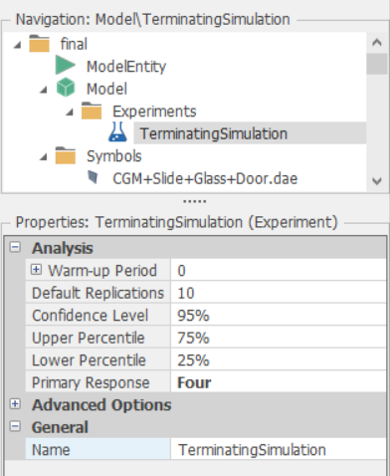
Start simulation experiment with 100 runs at the beginning
We initialize our simulation experiments with 95% confidence level

Slide 5
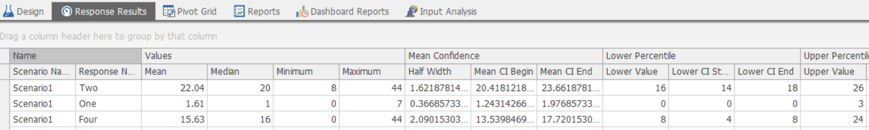
Each row represents the statistic summary of the number of students rejected from different groups
Result: Based on the first 100 simulation experiment runs, we can conclude that under 95% confidence level, 22 students of group 2 and 2 single students will fail to find a seat within give accuracy
However, we cannot draw a conclusion about students of group size 4 since the half width of the confidence interval is greater than 2
We can find the half width of the confidence interval from this column

Slide 6
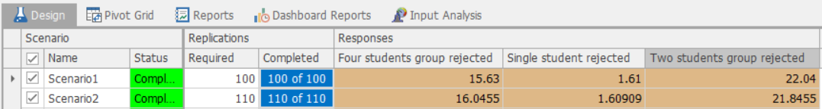
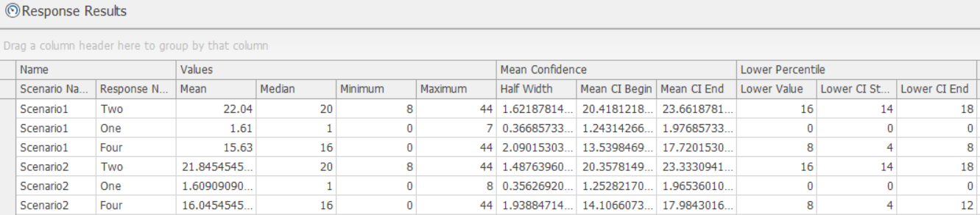
We increase the number of simulation runs by 10 for the second scenario
This time we have arrived at the half confidence interval smaller than 2, therefore, we can conclude that with 95% confidence level and 110 simulation runs, the estimate of average number of group 4 students failed to find seats is 16

Slide 7
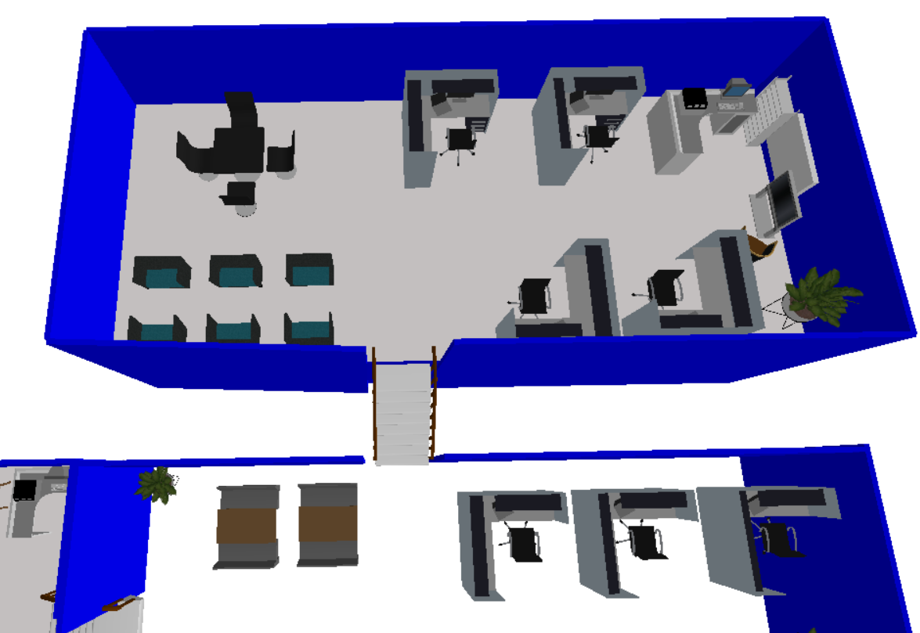
Question2: How many new seats should be added so that the number of group 2 and 4 students being rejected will not exceed 5 with current confidence level and accuracy?
Approach： Add one more 4-pax seat and 2 more 2-pax seat and rerun 110 simulations
Newly added seats

Slide 8
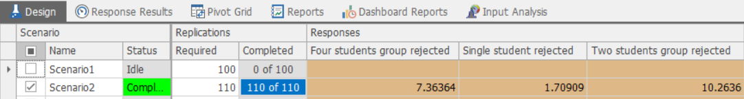
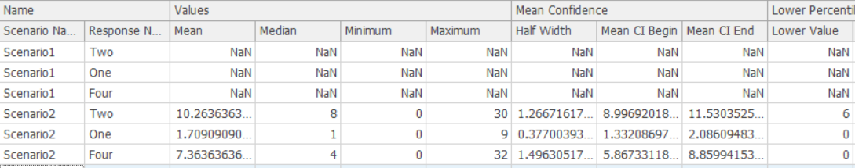
We run another 110 simulations
However, the result shows both values are greater than 5, meaning that with current confidence level and accuracy, there are still more than 5 students from group size 4 and 2 cannot find seat throughout the day
We need to add more seats!!

Slide 9
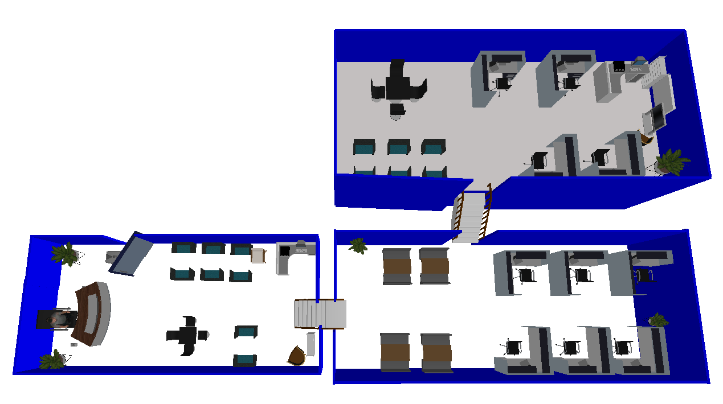
We add two more 2-pax seat and one more 4-pax seat and run 110 simulations again
Newly added seats

Slide 10
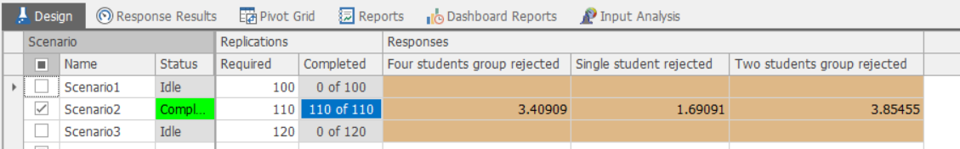
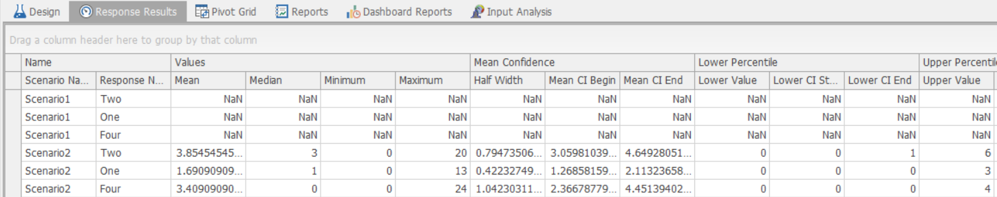
We add two more 2-pax seat and one more 4-pax seat and run 110 simulations again
Conclusion: If we want to have less than 5 students be rejected throughout the day, we need to add 4 2-pax seats and 2 4-pax seat, but our model is always scalable to cater to different requirements!!!
This time we have achieved total number of students rejected less than 5 for all groups with low variance !!

Slide 11
System comparison
We want to compare the performance of two systems – the current system and the system with one more study table in terms of the balance between student satisfaction and the overhead caused by additional facilities.
Adding additional study table will not only decrease the number of students being rejected, but also decrease the utilization of the corresponding type of study table.
The trade-off between the two factors is defined as μ = a·X1 - b·X2, where
X1 -- the number of students in different group size rejected by the system in one simulation;
X2 -- the average utilization of each type of study table;
a -- the significance coefficient of X1;
b – the significance coefficient of X2.

Slide 12

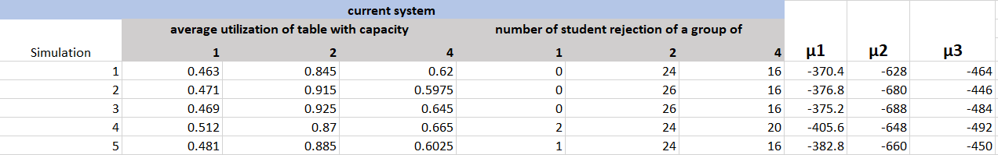
Modeling process
E.g. a = 2, b = 800
To put the value of study table utilization to the same level as number of students being rejected.
20 simulation runs were ran to get the average utilization of table with different capacity and the number of students being rejected of different group size.
μ is calculated by μ = a·X1 - b·X2 from each simulation run. The small the value of μ is, the undesired the system is.
The same process was done on a new system with one more study table. μ1᾽, μ2᾽ and μ3᾽ was obtained.

Slide 13
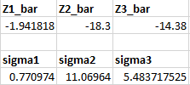
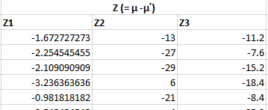
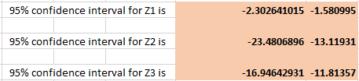

Modeling process
¯
is the mean of the sum of Z value for 20 simulation runs.
Z
σ is the standard deviation of all Z values.
Z = μ -μ᾽.Thus,
Z1 = μ1 – μ1᾽
Z2 = μ2 - μ2᾽
Z3= μ3 – μ3᾽
The confidence interval is calculated by
Conclusion
If Z < 0 , system 1 has a smaller μ value compared with system 2. Then, system 1 is preferable;
If Z > 0 , system 1 has a larger μ value compared with system 2. Then, system 2 is preferable;

